Slide 1

Inputs and Outputs Basics

Slide 2



Take Input From User
input() allows flexibility to take the input from the user.
Reads a line of input as a string.

Slide 3


Working with Strings String Concatenation
Joining strings together is called string concatenation.

Slide 4
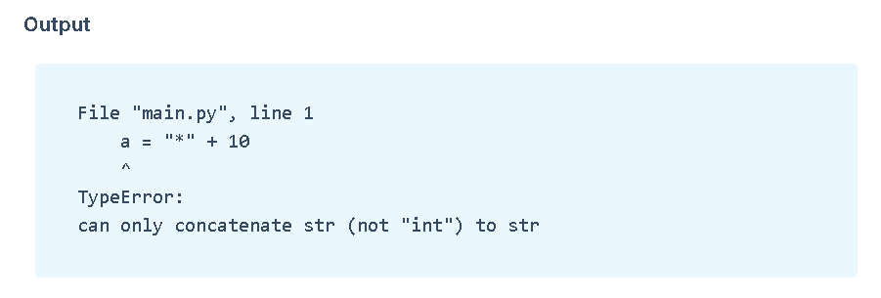

Concatenation Errors
String Concatenation is possible only with strings.

Slide 5


String Repetition
* operator is used for repeating strings any number of times as required.

Slide 6



Slide 7



Length of String
len() returns the number of characters in a given string.

Slide 8


String Indexing
We can access an individual character in a string using their positions (which start from 0) . These positions are also called as index.

Slide 9


IndexError
Attempting to use an index that is too large will result in an error:

